Slide 1
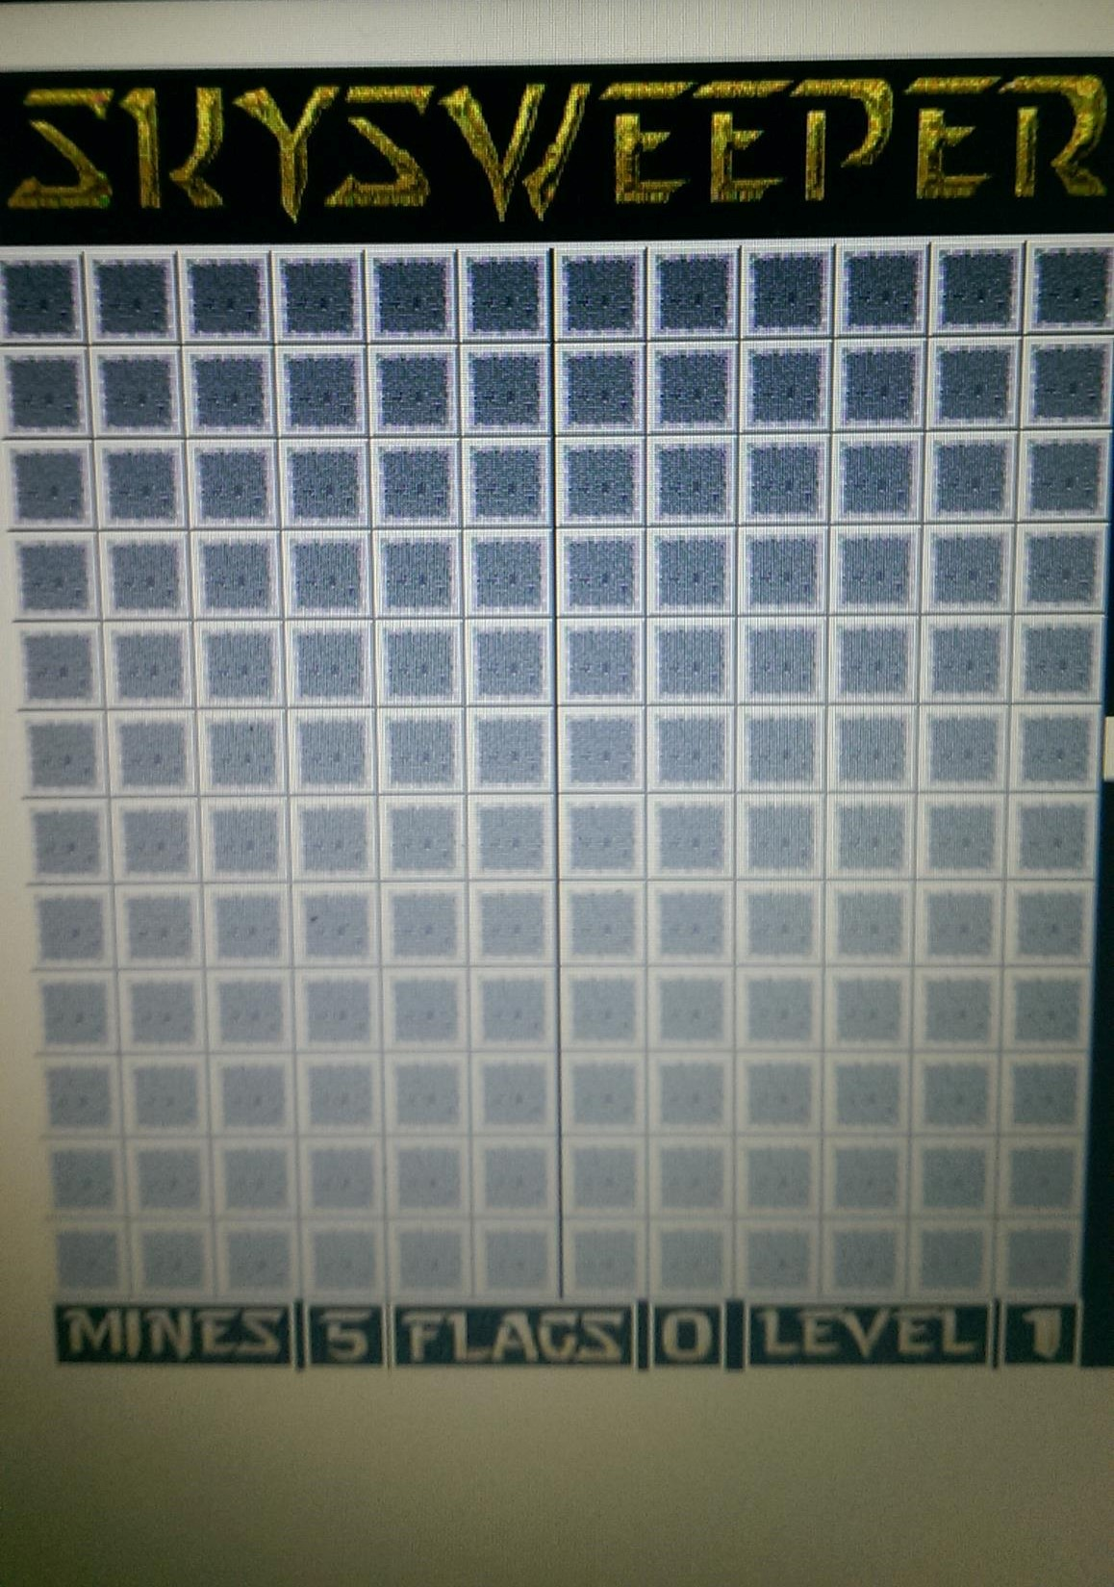
SKYSWEEPER
By: Zack Cloutet, Helen Kade, Mercy Karanja, Cody Rogers

Slide 2
About Skysweeper
Skysweeper is a single player game in which a player tries to clear a board filled with mines without hitting any of them.
The mines are arranged into different constellations from level to level.

Slide 3
How to Play Skysweeper
The aim of the player is to figure out what constellation is in what level and try to finish that level without detonating any of the mines before time is up.
The number of mines in each level is shown at the bottom left of the board.
Each player is given 2 minutes to complete the current level, once they have done do they may move onward to the next one.
If the player suspects a mine to be in a spot the player can flag that spot, continue playing and come back to that spot later if they choose to.

Slide 4
Before Play
Before a player gets to play the game the player is prompted to put their name in.
After Play
If a level is won the LED lights turn on, a smiley face is formed and a victory sound plays.
The player can then move onto the next level if they chose to.
If the player clicks a mine a fancy LED pattern displays twice and an explosion sound plays.
After the LED pattern displays with the sound the board is revealed to the player so they can see where the remaining mines are placed.

Slide 5
Why Skysweeper?
The name itself was thought up by Zach Cloutet. We were sitting around a table brainstorming when he says, “Idk I was thinking of calling it Skysweeper. It suits what we are trying to do.” After that it was decided.
Unlike minesweeper which is based primarily on luck, Skysweeper is based on the knowledge of the constellations.
Skysweeper tests a players knowledge of constellations. Though the constellations are placed in random positions on the board if a player has decent understanding of the constellation they are trying to solve they should be capable of figuring out the locations of the mines thus being able to flag them.
https://github.com/CRogers999/CSC-132-Minesweeper

